Slide 1

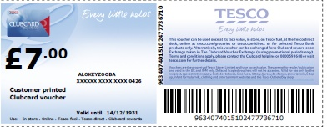
SMART VOUCHERS
- Spoorthy Kotian

Slide 2

Introduction
Voucher: Vouchers are normally recorded as Money value. They can be conditional on the customer spending over a specified value.
Vouchers currently issued by NGC should be redeemed only once. However, there are systematic checks to prevent multiple redemption .
The “Smart” in Smart Vouchers(22 digit code) denotes the unique barcode that is tracked in real-time to prevent multiple redemption of the same voucher.

Slide 3
Smart Voucher
The Smart Voucher System covers the activities that are involved in:
Generating a unique barcode for each Clubcard reward voucher issued to a customer.
Using the unique barcode to ensure that a Clubcard reward voucher is only redeemed once.
Providing the finance teams with information of the current voucher liability.

Slide 4
Description
Two unique Ids, a barcoded 22 digit EAN and a 12 digit alphanumeric code identify each Voucher. These are created prior to each quarterly Clubcard statement mailing on the NGC system ready for redemption requests.
Over 90% of Voucher redemption requests are from the store tills. The remainder are split between Tesco.com orders and Freetime Deals.
The tills expect a sub 2 second response to a redemption request from NGC. If the response is not received in time the till will accept the Voucher locally and inform NGC of the redemption via an offline message.
Any request to redeem an already redeemed Voucher will be rejected and logged in NGC.

Slide 5
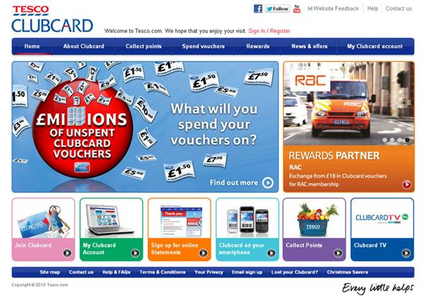
Business Objective
To ensure that cash vouchers issued are only redeemed once.
To reduce fraud and provide finance team with accurate picture of financial liability.

Slide 6
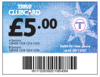
How does Smart Vouchers work?
Issue
Clubcard
/ Smart
1
Voucher to each customer.
Allocate each voucher a
11
Complete transaction
unique 22 digit barcode.
2
Record the 22 digit barcode in the
10
9611192011002118854064
Smart Voucher System with a status
Smart Voucher system sets Smart
of
‘
active
’.
Voucher to ‘redeemed’
3
9611192011002118854064
9611192011002118854064
Customer presents the
Smart
9
Till checks with the Smart Voucher
Voucher in a store or Self Service Till.
system that the Smart Voucher
number is still active
96 11 192
4
Till recognises the first 7 digits of the 22 digit Smart Voucher barcode as a Smart Voucher & begins the redemption process.
£
5.00
8
Till confirms that the total of all
vouchers does not exceed the
shopping basket cost
96 11 192
Till identifies the voucher value
Till confirms that the first 7 digits of
7
using the value code & a predefined 13 digit. EAN99 coupon. 9914650115001
5
the barcode are valid for the till:
Must be pre-defined on the till (Barcode Programming) for each Mailing (192 = mailing ID)
•
011
6
Extract digits 8 to
10 of the barcode to
identify the value code

Slide 7
Architecture
The Hardware Load Balancer and 2nd SV POS Integration server are shown with a dashed border. This is to indicate that their deployment is dependent on expected load. The number of SV POS Integration Servers could be increased further if warranted by expected / actual load.
The Auth Gateway (AG) Central component would also typically be deployed on multiple web servers fronted by a hardware load balancer.

Slide 8
In store transaction
1
2
Till
AG
LB
Production DB
Reporting DB
3
4
Till is the point where customer makes the transaction.
AG (Authorization gateway) supports multiple system through which transaction passes.
LB (Load balancer) based on round robin checks out which of the web server is free & thus balances loads between server.
SV architecture contains 4 web servers and 2 database servers.
Database servers are Production server and Reporting server.
Reporting server will be updated in 1 day delay on daily basis from production server and MCA will get the voucher details from reporting server

Slide 9
Online Transaction
1
2
online
LB
Production DB
Reporting DB
3
4
For online transactions 12 digits Alpha code is used and there is no offline transaction route.

Slide 10
Functionality
The following points are the main areas of
functionality:
Generate Barcodes & Apply to Smart Vouchers
Redeem Smart Voucher at Till or Self Service Till
In-Store Authorization Server
Smart Voucher Authentication Service
Un-redeem Voucher (Void till Transaction)
Card Enquiries
Voucher Re-Issues
Voucher Enquiries
Voucher Rollover Requests
Maintain Customer Account
Maintain Business Rules

Slide 11
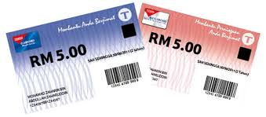
High level functional design
The functional design affects a number of different systems:
Barcode Programming (Creation)
NGC (Creation)
Smart Voucher (Redemption)
Smart Voucher (Customer Services)
Smart Voucher Reporting
Housekeeping

Slide 12

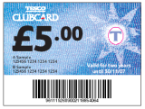
Voucher At Till
Coupon
Smart
Tills recognize the new 22 digit Smart Voucher barcode format and the 7 digit Smart Voucher prefix must be valid on the till. The till will identify the value of a voucher by translating the 22 digit code into the equivalent 13 digit barcode. The value of the voucher will be obtained from the 13 digit value barcodes held on the tills.
Setup
Voucher
System
IF05 Off line redemptions
System
IF06
Clubcard
used
Till Data Store
Validation requests for
Smart Vouchers.
Maintain value code to
voucher value details
Storeline
Store
System Support
Server
First seven digits of
Validate
Clubcard
Voucher
Smart Voucher
Convert barcode to voucher value
barcode for statement
mailing
Store
Store
Store
Checkouts
Checkouts
Checkouts
Customer
The till will communicate to the Smart Voucher central system via Authorisation Gateway.

Slide 13
Integration with other systems
Partner Boost
(Rewards)
Tesco Boost
(Big Exchange)
Dobbies
SMART VOUCHERS
NGC
SV CSC/MCA
Freetime
CG
IL
RTS
Till
Online Checkout
CCOLA
3rd Parties
E Pay

Slide 14

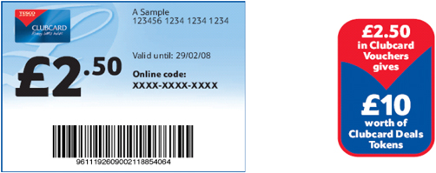
Appendix
Hub Link:
http://team.hub.tesco.org/HeadOfficeandCommercialIT/clubcardmarketingIT/Coupons_Vouchers/International%20Smartvouchers/Forms/AllItems.aspx

